Slide 1
What’s your Culture Club?
Cameron M. Cox, III, MHA, FACMPE
Coronis Health
Chapel Hill, NC

Slide 2
Learning Objectives
Identify tools for practice culture improvement
Discuss the methods for improving organizational culture with various stakeholders in a healthcare practice
Recognize how productivity and retention are affected by culture and generational shifts

Slide 3
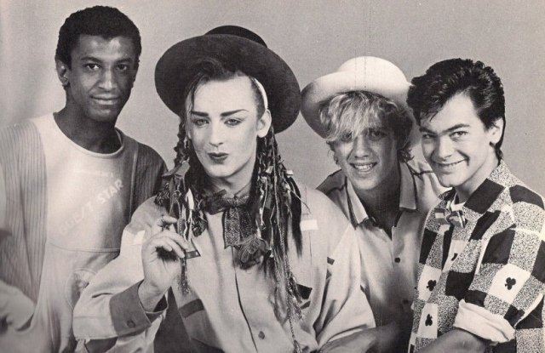
What’s your Culture Club?

Slide 4
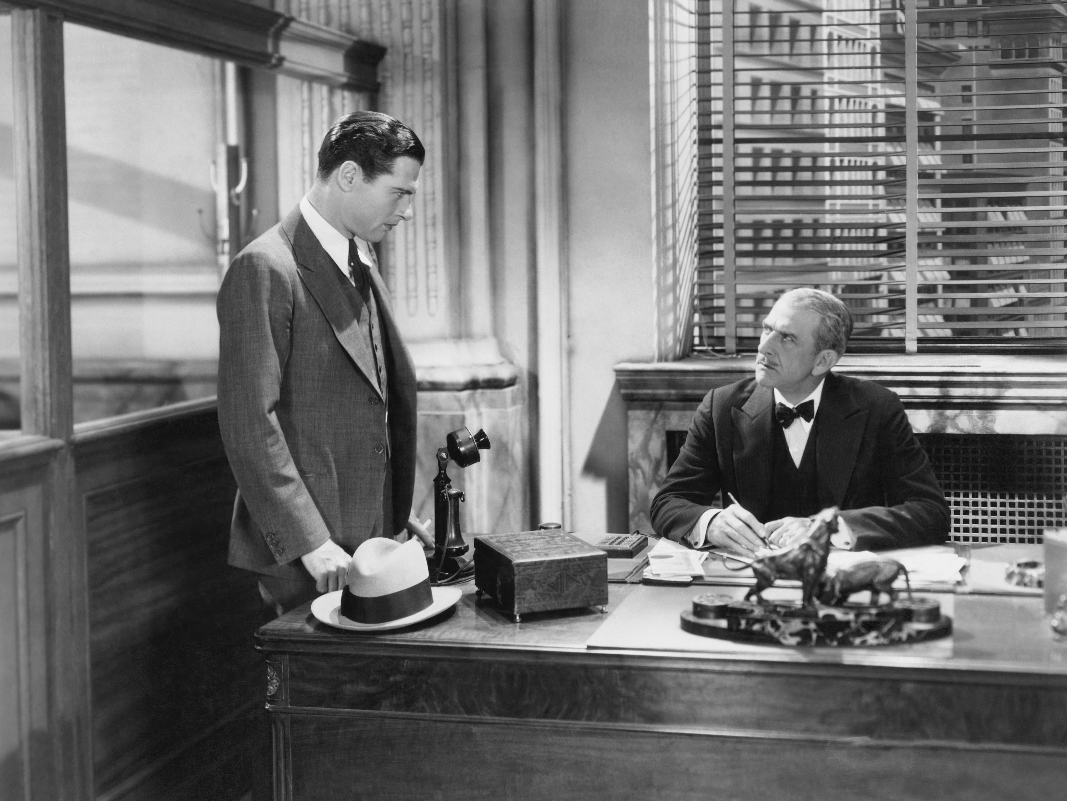
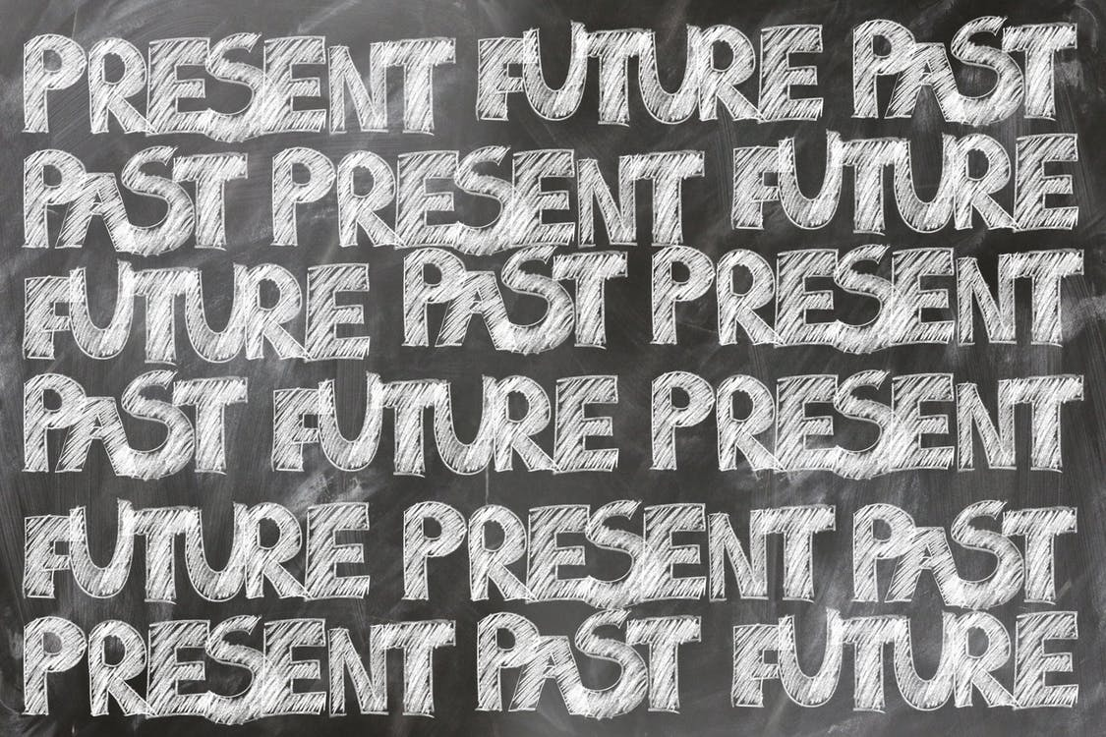
Though it may feel fluffy…

Slide 5
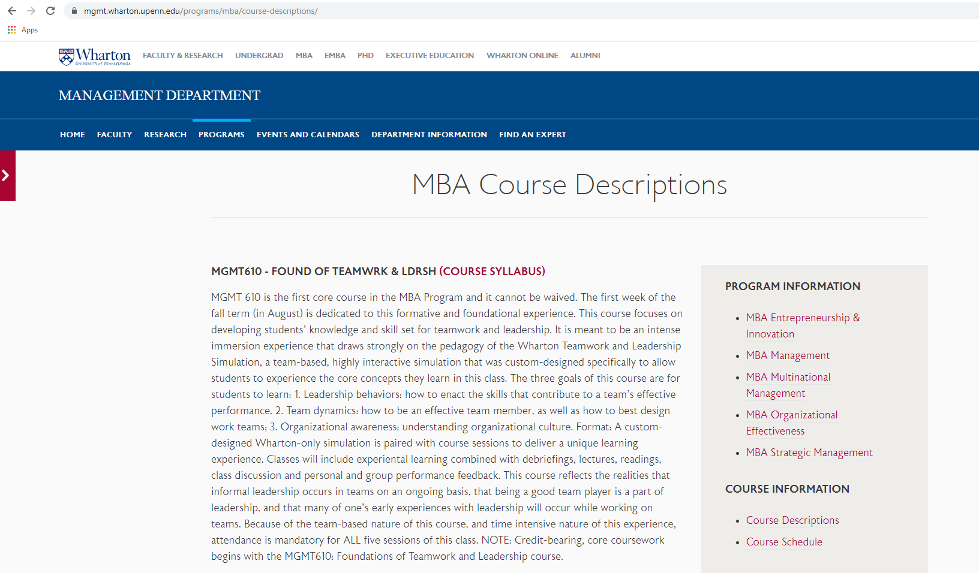
In fact, this is an actual class in some business schools ☺

Slide 6
Seems obvious enough….
…but can you define culture?

Slide 7
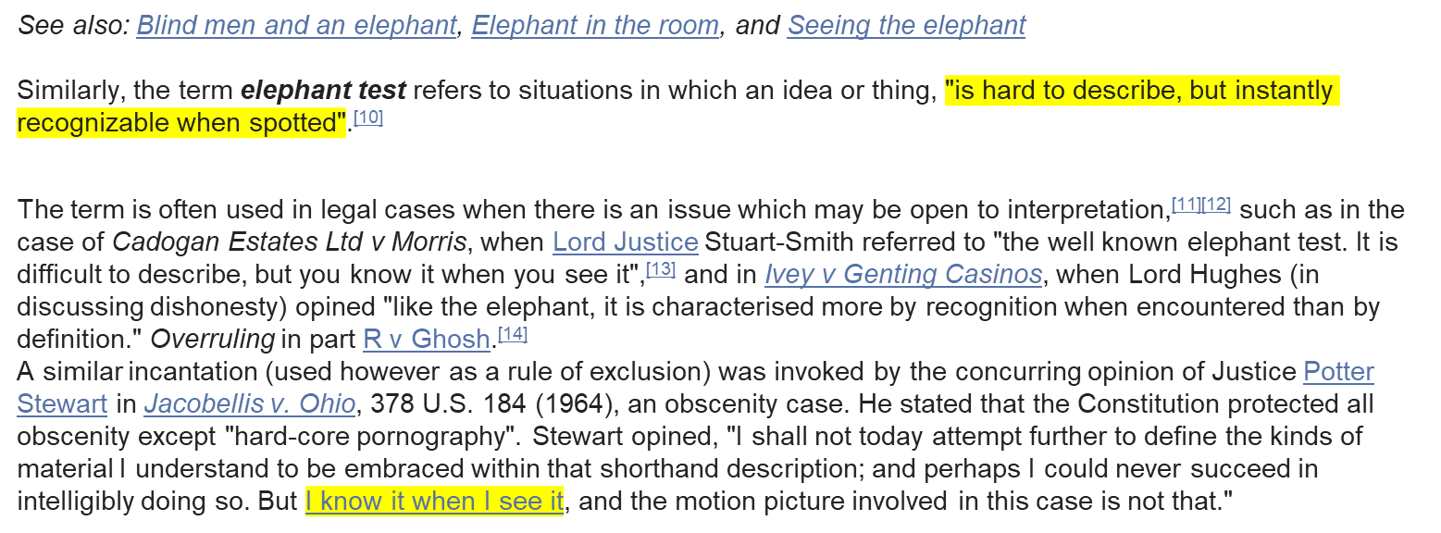
The Elephant Test

Slide 8
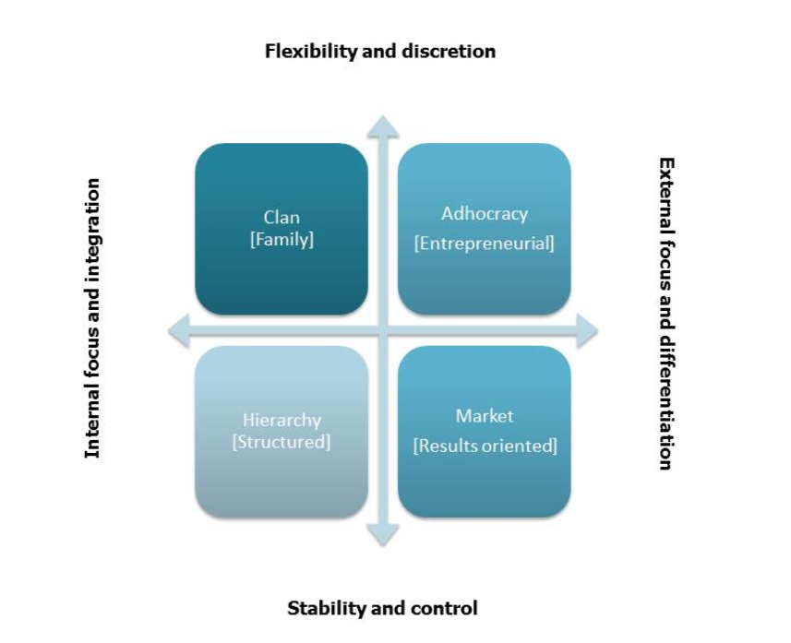
Let’s figure out the elephant in the room

Slide 9
Clan Culture
Leader Type: | Facilitator
 | Mentor
 | Team Builder
Value Drivers: | Commitment
 | Communication
 | Development
Theory for Effectiveness: | Participation Support Commitment

Slide 10
Adhocracy Culture
Leader Type: | Innovator
 | Entrepreneur
 | Visionary
Value Drivers: | Innovations
 | Creativity
 | Development
Theory for Effectiveness: | Innovativeness New Sources

Slide 11
Hierarchy Culture
Leader Type: | Coordinator
 | Monitor
 | Organizer
Value Drivers: | Efficiency
 | Timeliness
 | Consistency
Theory for Effectiveness: | Control Efficiency

Slide 12
Market Culture
Leader Type: | Competitor
 | Hard Driver
 | Producer
Value Drivers: | Market share
 | Goal Achievement
 | Profitability
Theory for Effectiveness: | Aggressively competing Customer Focus

Slide 13
This is where I encourage….
Finding a test that works for your practice

Slide 14
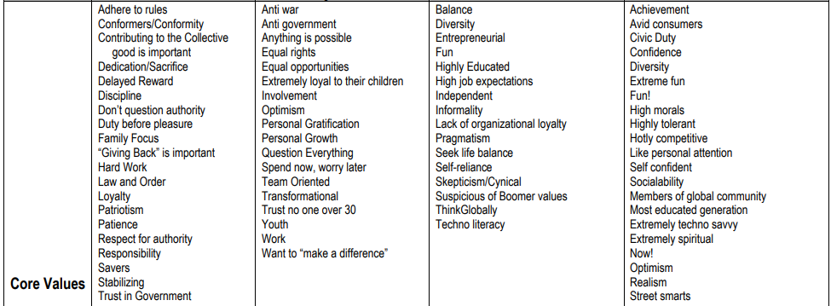
Culture and Generations
Not to be confused…generational shift can influence culture
Source: http://www.wmfc.org/uploads/GenerationalDifferencesChart.pdf

Slide 15
Organizational Culture has evolved into an important trait

Slide 16
Back to the elephant…
How do you define your business (practice) culture?
What is the personality of your business?
Can you highlight your core values?
What is your mission, your purpose?
What makes your business (practice) unique?
Define your environment.

Slide 17
Why does it matter?
Employee engagement
Attracts Talent
Enhance performance
Employees are more likely to WANT to work for an organization who aligns with his/her core values and cultural expectations.
You can attract more bees with honey. Southern euphemism meaning if you got a good thing going, others are sure to follow.
Workplace statistics have shown that strong cultures can foster an environment that outperforms its competitors financially and lead to generally more successful outcomes.

Slide 18
Stagnant is not healthy…
A startling statistic says that 80% of modern companies “don’t care about culture.” If that’s true, it’s really no wonder why so many companies seem to stagnate or tread water as they age.
Source: https://www.forbes.com/sites/williamcraig/2016/02/27/your-company-will-adopt-its-own-culture-whether-you-nurture-it-or-not/#3f9543a47781

Slide 19
If you choose to shift your culture… what should I do?
Stick to the company’s core values…and constantly remind everyone of their foundational aspect. We will dig deeper in just a second…
Constantly communicate purpose and passion of organization – internally and externally
Recognize and reward contributions
Allow the organization to be transparent
Sing the successes
Lament the failures
Share the challenges

Slide 20
Core Values – The Seed of Culture

Slide 21
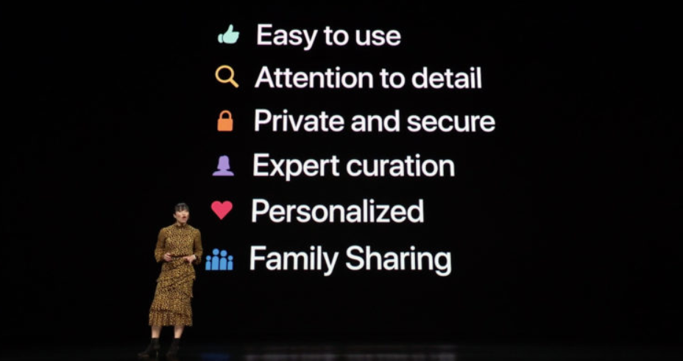
Make sure your values aren’t a secret… your culture is living the values
Source: Apple Slideshare: Slideshare.net
Source: http://www.tapsmart.com/features/apple-2019-five-core-values-will-affect/

Slide 22
Personal belief as an entrepreneur… culture’s breath comes from the owner(s)
Shout out some famous entrepreneurs who breathed culture into their organization

Slide 23
But…let’s be clear… culture should be pervasive
This is top down and bottom up

Slide 24
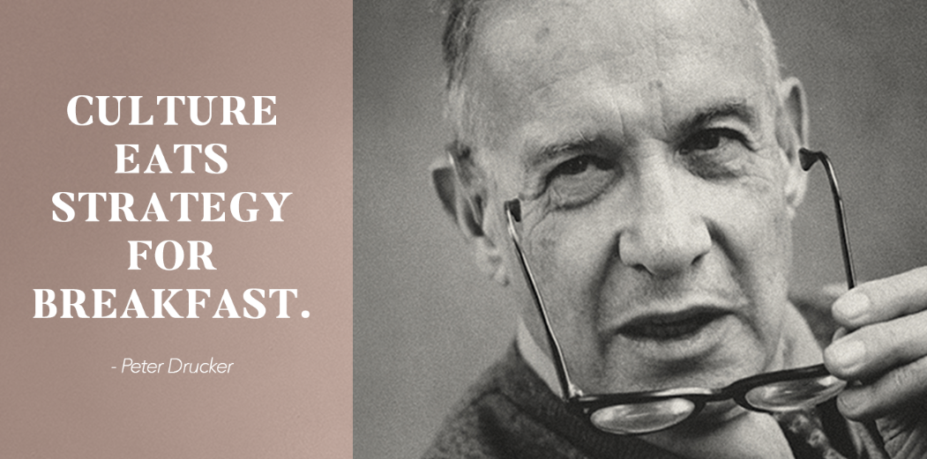
The ultimate reason why culture is so important top down

Slide 25
….emphasized the top clearly… what about everywhere else…
Embrace autonomy:
Let people succeed and fail
Give and receive feedback
more than just annual reviews and checking the box
Build a team atmosphere
it is where healthcare is going (or already is ☺)

Slide 26
Let people do
When you look at this, what do you see?
Win or Fail?

Slide 27
Real world example of feedback?
Everyone in the organization should get ALL feedback….not just the bad ☹

Slide 28
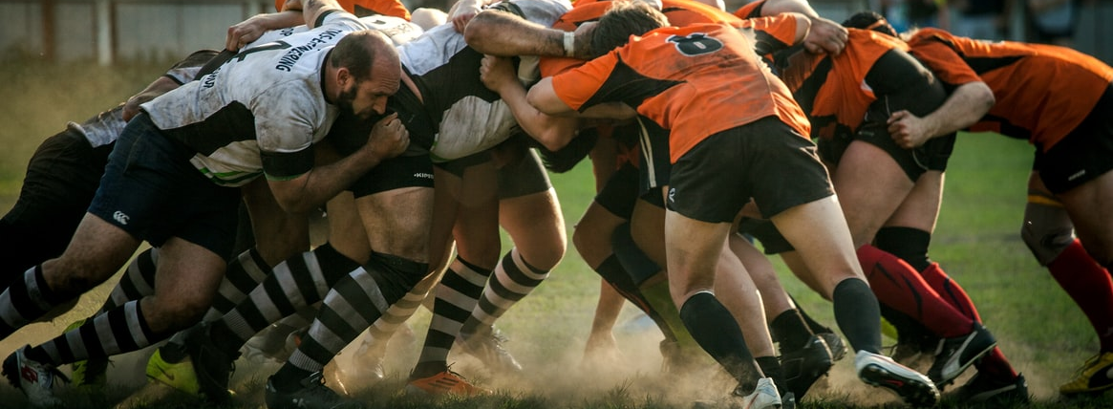
Team effort – Fact (as my millennial would say)

Slide 29
Awesome…I’m feeling just a little fluffy…
Bet what you’re really thinking…So how exactly does this help me?!?!?!

Slide 30
So what can a healthy culture do for my practice?
Retention
Production
Turnover is extremely costly and destructive
HR Processes should be wrapped around culture
Seek candidates fits to the organizational culture
Culture becomes a badge of honor
Action speaks louder than words – adhere to values for maximum by in by all
Transparent organizational culture provides clarity into organizational objectives
Nurture the duality of human nature to find balance

Slide 31
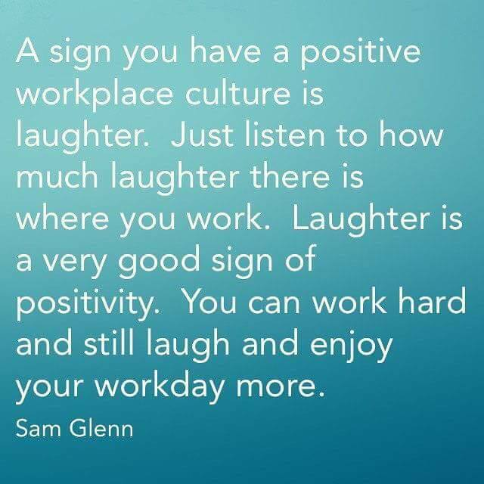
I can safely say that we have this culture where I work…

Slide 32
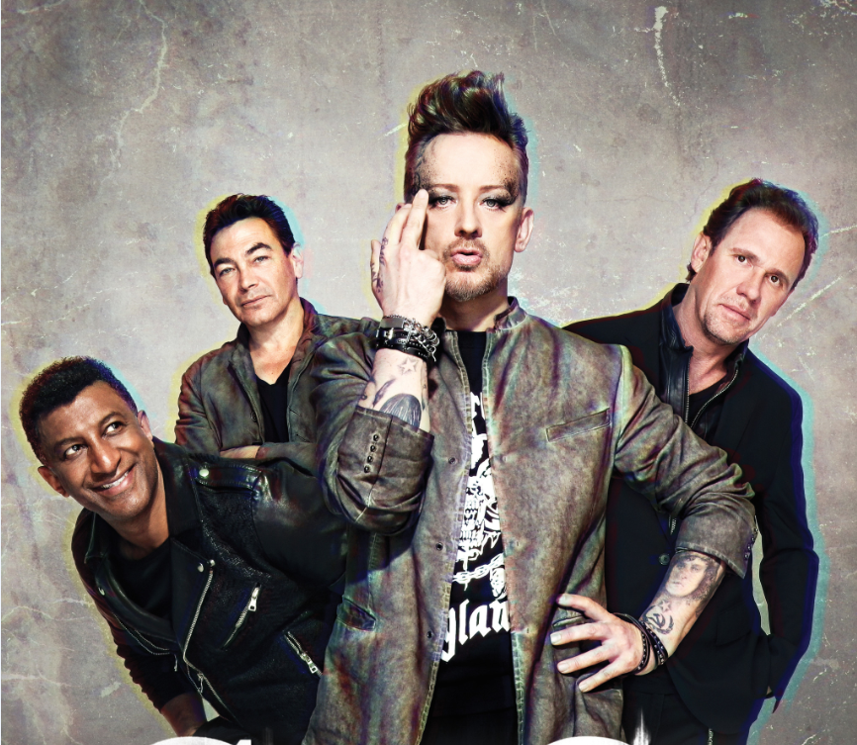
Figured out your Culture Club?

Slide 33
Thank You
Thank You
Coronis Health
(877) 983-1234
5963 Exchange Dr Ste. 114,
Sykesville, MD 21784
www.coronishealth.com

