Slide 1
Marketing to the Next Generations
Michael Cash, MHSA, FACMPE
Notes:
Marketing to the Next Generations
Overview: As our population changes, so do the wants and needs of our patients. In this presentation we will discuss the challenges of marketing in healthcare, define the next generation’s patient, their expectations and influences, and discuss marketing techniques for targeting the next generations.
Objectives:
Identify the challenges of marketing in healthcare
Define the next generation’s patient, their expectations and influences
Provide marketing techniques for targeting younger generations
Delivery: Conferences/Professional Meetings, Virtual
Audience: Physicians, Practice Executives
Approximate Length: 45 minutes – 1 hour
Michael, Leslie (Oklahoma/Arkansas or Virtual)
As our population changes, so do the wants and needs of our patients. In this presentation we will discuss the challenges of marketing in healthcare, define the next generation’s patient, their expectations and influences, and discuss marketing techniques for targeting the next generations.

Slide 2
Objectives
1
Challenges and changes in patient experience
01
Learn why healthcare is different than other industries and how patient expectations are changing
2
Who are the next generations
02
Discuss population demographic and generational differences in healthcare
3
Generational expectations and Influences
03
Identify characteristics, influences, and needs of younger generations
4
Targeting younger generations
04
Review website, social media, and reputation management
Discuss ways to use virtual scheduling, form automation
Review convenience and telemedicine

Slide 3
Challenges to Improving Patient Experience
Legal Risk
Heading
Data Security
Payers
Heading
Complexity of Workforce
Human Connection
Heading
Fragmented Systems
Multiple Constituents

Slide 4
Healthcare Consumerism
“healthcare consumerism” to mean the personal choice and responsibility in paying for and managing one’s own health.
Deductibles & Coinsurance
Patient Expectations
Consumer Accounts (HSA, FSA)
Subscription-based Healthcare
Telemedicine
Notes:
https://patientengagementhit.com/news/breaking-down-the-basics-of-healthcare-consumerism
healthcare consumerism” to mean the personal choice and responsibility in paying for and managing one’s own health.
The term, which gained notoriety both as value-based care took hold and high-deductible health plans (HDHPs) became commonplace, demonstrates that the patient has become one of the primary payers of healthcare and primary drivers of wellness.
In terms of HDHPs and patients as payers, patients have increasingly been on the hook for a considerable bulk of their medical costs. Because of higher deductibles, patient financial responsibility has gone up.
This has led to another aspect of healthcare consumerism: the patient experience. Because patients are paying higher out-of-pocket healthcare costs, they are looking for a healthcare experience that mirrors those they have in other service sectors. Healthcare consumers are demanding healthcare experiences that are as frictionless as those in the hospitality, airline, or ecommerce industries.
Provider groups have followed suite by implementing technologies that make it easier for patients, or consumers, to shop for healthcare and interact with the system.
Organizations looking to adjust to healthcare consumerism may consider three key concepts: affordability, access, and experience

Slide 5
Lessons Learned from the Buggy Whip Maker
Are we scanning the environment for emerging factors that may affect the future of the business?
Are we so caught up in the day-to-day activities of running our business that we don’t notice a development that might be the equivalent of the first auto?
Are we clinging to the hope that most people would not want one of those noisy, newfangled contraptions?
Companies that survived transitioned to transportation accessory makers.
Notes:
https://www.succeedinginsmallbusiness.com/history-lesson-for-small-business-owners-dont-be-the-last-buggy-whip-maker/
Are we scanning the environment for emerging factors that may affect the future of the business.
Are we considering trends – such as a rise in the cost of labor and overhead that impact profit margin? Are there shifts we can make to improve efficiencies.
Blockbuster Failed to adopt online streaming
Kodak created digital cameras but failed to implement due to profitability of film.
Sears/ Kmart failed. Did not adapt to rise in internet, consumer expectations.
Target, for instance, has invested billions into transforming its network of stores into strategic distribution centers. With its embrace of omnichannel – providing customers with seamless desktop, mobile, and in-person shopping experiences – Target put its brick-and-mortar locations to work as a core component of a digital strategy, where it would leverage its physical facilities to fulfill the orders of digital custome

Slide 6
Who are the next generations?

Slide 7
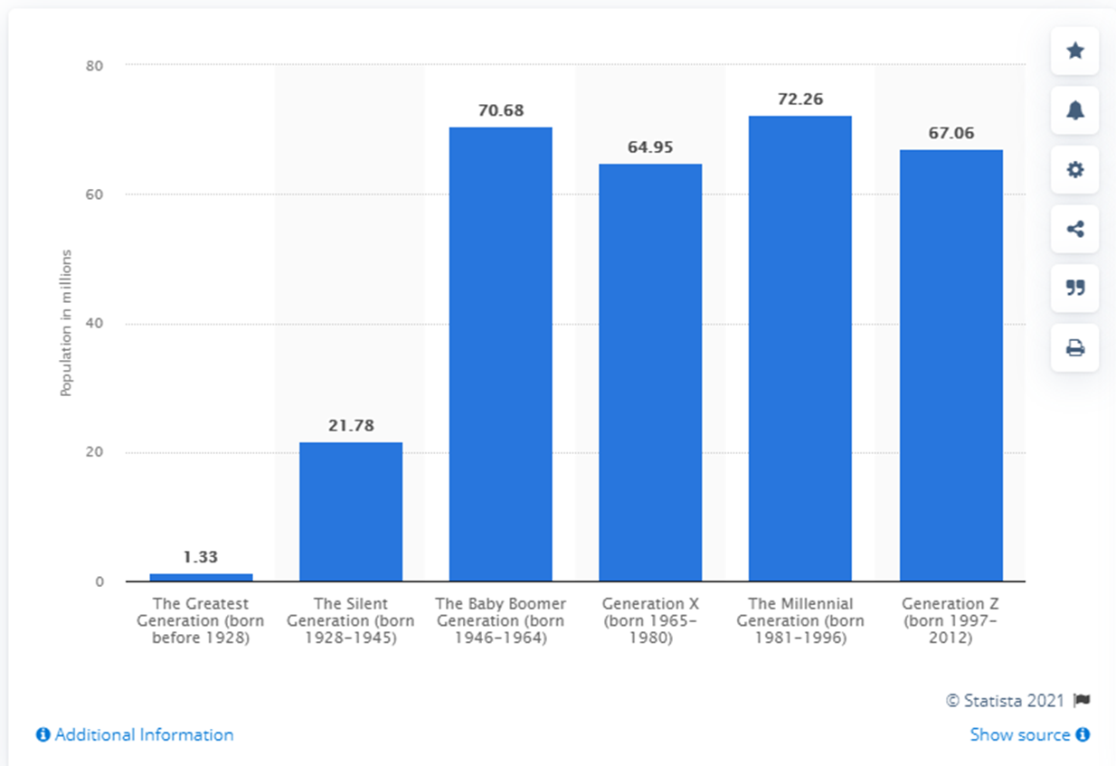
Population by Generation
https://www.statista.com/statistics/797321/us-population-by-generation/

Slide 8
Generational Differences in Healthcare
Silent Generation
more likely to follow doctor’s orders
Boomers
seek counsel from their physician
Gen X
more likely to get privately educated before visiting a physician
Millennials
more apt to look for all types of connected healthcare
Notes:
https://www.hmpgloballearningnetwork.com/site/ihe/article/how-generational-factors-impact-patient-engagement
Silent Generation (ages 74 and older) is more likely to follow doctor’s orders.
Baby Boomers (ages 56–73) are more likely to debate with their doctor.
Gen Xers (ages 35–55) are more likely to get privately educated before visiting a physician.
And millennials (ages 16–34) are more apt to look for all types of connected healthcare.
Silent Generation They’re prepared to defer researched information to their physician’s opinion. Their clinical visits are more frequent and longer due to clinical acuity and patient preferences centered on their medical care. They have firm beliefs in good service, having grown up during a time when “the customer is always right.”
Baby Boomers want to be engaged in their medical care. They seek counsel from their physician, often asking his or her opinion on researched material for specific care.
Generation Xwants to be engaged and educated. Relatively healthy, they’re notably curious and actively seek information. They assume healthcare providers and their staff are knowledgeable. They’re less likely to be loyal to a certain provider. They’re more likely to switch physicians and hospitals based on their most recent experience, not their overall past experience.
Millennials want to be connected. They access the health system through primary care providers (PCPs), urgent care centers and OB/GYNs. They have a low use of inpatient and outpatient services, but when used they typically come through the emergency department or maternity. They use and appreciate technology, have a positive personal relationship with their physician and value health information from multiple sources. If they lose confidence in the care provided in their most recent experience, they’re more likely to switch physicians or hospitals.

Slide 9
Do not have a PCP by age group
18-29
45%
30-49
28%
50-64
18%
65+
12%
https://www.kff.org/other/slide/one-fourth-of-adults-and-nearly-half-of-adults-under-30-dont-have-a-primary-care-doctor/

Slide 10
Generational Expectations and Influences

Slide 11
Stress Impacting Factors
Suicide rates
Harassment reports
Abortion laws
Future of nation
Presidential election
Pandemic
Health Care
Mass Shootings
Climate Change
Uncertainty in future
Discrimination
https://www.apa.org/news/press/releases/stress/2020/sia-mental-health-crisis.pdf
Notes:
When considering the physical and emotional toll of increased stress, nearly half of adults (49%) report their behavior has been negatively affected. Most commonly, they report increased tension in their bodies (21%), “snapping” or getting angry very quickly (20%), unexpected mood swings (20%), or screaming or yelling at a loved one (17%)
While older Americans may be able to embrace the feeling of “this, too, shall pass,” Gen Z adults (ages 18–23) are at a pivotal moment in their lives, experiencing adulthood at a time when the future looks uncertain.
Gen Z adults report key issues as a significant source of stress in their life, given that they have largely grown-up during times of disruption and unrest.

Slide 12
Mental Health Concerns
https://www.statista.com/statistics/943822/us-excellent-mental-health-status-by-generation/

Slide 13
What Younger Generations Expect
They research their options thoroughly
They expect upfront, transparent cost estimates
They expect access to apps for scheduling appointments
They have different interpretations of being "healthy" than past generations
Understanding the “why” for Gen Y: What Millennials are looking for in healthcare practices (mgma.com)
Notes:
They research their options thoroughly. Around 38% of this generation trusts their peers more than their physicians. More than 55% of them consider the information they find online to be as reliable as that offered by a doctor. Millennials are twice as likely as older generations to act on health advice they find online. Plus, nearly half of them use reviews to find healthcare providers.
They expect upfront, transparent cost estimates. Millennials prioritize and expect price transparency in all areas of their lives. This cash-strapped generation is twice as likely as Baby Boomers and Gen Xers to request cost estimates before undergoing medical procedures and treatments. They are also more likely to forgo treatments that are out of their price range.
They expect access to apps for scheduling appointments. 71% of Millennials surveyed prefer scheduling medical appointments via apps, and 60% want access to virtual doctor’s visits. A significant percentage of young people prefer post-care follow-ups via text message, chatbot or email as opposed to traditional phone call check-ups.
They have different interpretations of being "healthy" than past generations. According to an Aetna survey, Millennials are twice as likely as Boomers and Gen Xers to include exercising frequently and eating healthily in their definitions of overall health. This generation is also interested in holistic and alternative forms of healthcare. 71% of them believe that good health should include both physical and mental wellness.
Providers can target by:

Slide 14
Personalized Healthcare
Needs
Acknowledged as individuals
Presented with options
Feeling connected
Seeking authentic experiences
Motivation
Trust relevant, authentic opinions from real product users they can relate to
Do a lot of their research via blogs, forums, and YouTube videos
Align themselves with organizations doing good in the world
Notes:
https://blog.hubspot.com/marketing/marketing-to-millennials
Many younger people place a large degree of trust in the recommendations of influencers, so they look to online reviews, social media.

Slide 15
Taking Responsibility to Stay Healthy
willing to pay more for healthy products
take the initiative in researching medical issues
dedicated to eating healthier foods and staying fit
manage their healthcare conditions and lifestyle with a wearable device or mobile app
Notes:
https://medcitynews.com/2019/10/5-ways-millennials-and-gen-z-are-revolutionizing-the-healthcare-industry/
Healthcare providers offering advice/treatment based on data gathered via wearable devices may be more engaging to younger generations.
Accenture’s 2019 Digital Health Consumer Survey found that 51 percent of respondents manage their healthcare conditions and lifestyle with a wearable device or mobile app. Technology allows them to take more responsibility for their health than previous generations could.
Millennials are more likely to take the initiative in researching medical issues, too. This demographic admits to holding little trust in medical professionals, with 55 percent viewing online resources as equally reliable. Similarly, Gen Z is “less trusting of brands […] because they’ve grown up in an era where information was available at all times,” according to Emerson Spartz, CEO of Dose.
Millennials are more dedicated to eating healthier foods and staying fit than older generations, while Gen Zers are more willing to pay more for healthy products than older age groups.
Healthcare providers need to revise the way they deliver care and interact with patients to build trust in younger generations. Taking the time to explore their community’s expectations may enable medical professionals to stay relevant, as technology increases the availability of healthcare tools and information.

Slide 16
Younger Generation Needs
93%
Want a provider relationship
85%
Feel that providers only care about them when they are sick
90%
Want support for emotional/mental health, adequate sleep and positive family relationships
80%
Want providers to know more about health interests, goals and motivations
Notes:
https://www.aha.org/aha-center-health-innovation-market-scan/2019-12-17-millennials-speak-about-their-health-care

Slide 17
Clinician Perspective - Drivers of Change
86%
of clinicians agreed the rise of patients informed about their health conditions is driving healthcare change
of clinicians agreed that quality measures, including patient satisfaction, have driven change in healthcare in the last decade
90%
62%
of clinicians agreed the role of the clinician will change to be more of a partnership with the patient in 10 years’ time
56%
of clinicians agreed patients will be more empowered to take care of their own health
Forbes -unless-we-future-proof-healthcare-study-shows-that-by-2025-75-of-healthcare-workers-will-leave-the-profession

Slide 18
Targeting the Next Generations

Slide 19
How to Target the Next Generations
Virtual consultation and patient record access
Online consultation scheduling
Reduced wait times
After-hours and weekend consultations
A well-maintained social media presence
Understanding the “why” for Gen Y: What Millennials are looking for in healthcare practices (mgma.com)
Notes:
Medical and healthcare providers can target this demographic by offering:
Virtual consultation and patient record access. Like Gen Z, this generation grew up in the age of technology, and they expect its incorporation in their healthcare options. A monumental 92% of Millennial patients want complete two-way electronic communication with their healthcare providers. A further 83% of them seek out doctors who allow them to access their patient data online. Clearly, digital patient portals and telehealth services are essential for younger patients.
Online consultation scheduling. 71% of Millennials who participated in a Jefferson Health Survey expect their providers to offer online scheduling services. Implementing digital scheduling will benefit your own practice, as it enables your clients to make appointments 24/7 instead of only during business hours. Online services make it easier for patients to book with you on their schedules. This will make them more likely to choose your practice over your competitors.
Reduced wait times. Millennials expect to see a doctor almost immediately. Implementing same-day appointments and minimizing wait times will allow you to grow your practice and attract more Millennials.
After-hours and weekend consultations. Millennials are busy, and many of them work two or more jobs to make ends meet. You can meet their needs and attract younger patients to your practice by offering convenient healthcare options that fit their schedules. Millennials are more likely to choose your practice if you offer evening and weekend hours. This may mean that your initial business plan requires an overhaul. But adjusting your consultation times could greatly influence your appeal and profit margins.
A well-maintained social media presence. Millennials grew up using social media. They rely on social media (e.g., Instagram, Facebook and Twitter), search engines and review sites to find testimonials and information about your practice.

Slide 20
Convenience is King
More receptive to telehealth visits
More likely to use walk-in clinic or opt for urgent care
Look to email, texting and apps to manage their appointments for communication
Want easy access to healthcare data
Notes:
https://www.abbott.com/corpnewsroom/products-and-innovation/how-gen-z-is-affecting-healthcare.html

Slide 21
Telehealth Adoption
More than 70% of physicians surveyed work in practices that use video conferencing
58%
diagnose or treat patients
59%
manage patients with chronic disease
50%
provide care to patients with acute disease
34%
preventative care visits
Telehealth has grown by leaps at doc practices, with wide variance in usage patterns | Healthcare IT News

Slide 22
Scheduling Inefficiency
Patients can only call during business hours
They are put on hold
Navigate the phone commands
Cannot see appointment availability

Slide 23
Patient Self Scheduling
75% of patients rank the ability to book and modify appointments online as important
100%
90%
80%
Reduced patient no-shows
70%
60%
Enhanced patient experience
50%
40%
Increased practice efficiency
30%
20%
10%
https://www.softwareadvice.com/resources/patient-self-scheduling/

Slide 24
Reasons to Change Providers
Baby Boomers
Millennials & Gen Z
Gen Z
28%
31%
23%
secure communications with their provider
better digital healthcare management tools
appointment reminders
Patients Switch To Doctors With Digital Tools | PYMNTS.com

Slide 25
Embracing Technology
People of all ages use banks, maps, travel and entertainment and have adapted to technology
People of all ages use direct deposit and pay bills electronically rather than stand in line to cash a paper check at the bank.
When was the last time you pulled atlas out of the pocket of the passenger seat?
When was the last time you picked up a phone book?
Nobody wants to find time in their busy day to figure out what hours their clinic is open, track down the phone number, call, and navigate through multiple menus only to be told that the staff is off for lunch until 1 p.m. and to please call back later.
https://www.fiercehealthcare.com/tech/industry-voices-great-service-surpasses-tech-fears

Slide 26
Online Presence
Beautifully designed websites
Updated, features work, contact information, forms
Strong social media accounts
Helps build relationships with the community and shows you care beyond the visit
Positive reviews
Patients review you online before attempting to schedule
A flawless reputation
Providing excellent customer service, order processes, and site configuration can help generate a positive experience
Millennial Marketing: How To Sell To Them (2021) (bigcommerce.com)

Slide 27
Online Reviews
Evaluate Physicians
80%
patients who responded to the survey use online reviews to evaluate physicians
Finding a Physician
71%
surveyed patients use online reviews as the very first step to finding a new doctor
Patients Viewing Surveys
65%
report using them “often” or “sometimes,” while a quarter of respondents use them “rarely
https://www.softwareadvice.com/resources/how-patients-use-online-reviews/

Slide 28
Do’s and Don'ts for Online Reviews
Do’s
Know the driving force behind online reviews
Be Proactive
Claim your business pages
Listen
Take it offline
Read the fine print
Don’t
Don’t underestimate the power of online reviews
Don’t post fake reviews
Don’t violate HIPAA
Notes:
Know the driving force behind patient reviews: Patient Experience- Every patient is a potential reviewer. How you interreact with your patients is as important as their actual medical treatment. Reviews tend to focus on how they were treated by the staff and the attitude of the physician. They are rating you based on how they feel when they leave, not the information that they were given.
Be Proactive: Encourage patients to post positive reviews and direct them to the review sites you want them to use by providing them with links, QR codes or having some sort of visual indicator of the sites you would like them to leave reviews, or if possible, have a tablet at checkout so patients can leave a review immediately. Top two sites are Google Reviews and Healthgrades.
Claim your profiles on these sites and provide accurate information and links to your website. This will help to ensure the correct information is being given to anyone searching for your practice.
Listen: Often, negative reviews cause us to have a knee-jerk emotional reaction, but it is important to be mindful of how you interact with patients online, whether they leave or positive or negative review. It is best to use negative comments as a learning opportunity. As a physician, you may not be aware of all the activities within your office. Things go wrong and negative comments can shed light on these issues.
Take it offline: If you chose to reply to comments, whether good or bad, do so with a simple “Thank you for your comments. Please contact our offices if you would like to discuss this further”. From that point, all communication needs to be offline. Depending on the comment, you may want to contact the patient rather than waiting for them to contact you.
Read the fine print: Know what the rules are for each review site. If patients post multiple negative comments, check to see if this violates the rules of the website. You may be able to get certain reviews removed by flagging them for the website administrator to review.
Don’t underestimate the power of online reviews: Looking at the numbers, 43% of patients say they will go out of network because of a positive review—important to keep that in mind because this means patients are willing to pay more out of pocket to see a physician with good reviews. https://statuslabs.com/online-reputation-management-doctors/
Don’t post fake reviews: (on your own profile or on those of your competitors, sadly I’ve seen this before) It is important to be genuine, so if you have a great experience with a patient, ask them to leave you a review.
Don’t Violate HIPAA- As mentioned above, it is safest to take it offline when responding to a comment, positive or negative, to avoid any sticky HIPAA issues.

Slide 29
Physician Review Sites
https://www.softwareadvice.com/resources/how-patients-use-online-reviews/#1

Slide 30
Waiting Room and Intake/Checkout Process
Traditional waiting rooms can be very unhealthy
Patients are less tolerant of wasting their time
Practices want and need to run their offices more efficiently, and traditional methods are outdated
Evaluate which aspects of the patient visit, such as check-in, patient education, financial counseling, etc., can be moved to phone, video, or online
The Doctor Will See You Now (repertoiremag.com)

Slide 31
Waiting Room Efficiency
Electronic Check-in
Demographic & insurance updates, co-pays, patient forms complected electronically before the visit
Patient Education
Delivered electronically before or after visit to prepare patients with alternatives, procedures and or follow ups
Car Waiting
Use of apps or texting to allow patients to wait in the car prior to the appointment
Check-out
Check-out and schedule follow up appointments in exam room
Testing & Vaccines
Drive through vaccines and/or allow patients to skip waiting room
The Doctor Will See You Now (repertoiremag.com)

Slide 32
Price Transparency
Patients are exhibiting more traditional “consumer behaviors” each year, implying that more patients are actively shopping for their health care
Providers offering new tools and technologies will be in a favorable position to increase market share and improve patient satisfaction.
Younger generations typically prefer quicker, efficient services and transparent information rather than a long-term, trusted relationship with their PCP.
Deloitte - Putting a price on transparency

Slide 33
Question Process to Improve Experience
How can we improve communication with patients?
How can we make it easier for patients to access health information?
How can we improve convenience?
How can we empower patients?
How can we stay engaged with patients?

Slide 34
Questions

