Slide 1
Best Practices for Presenting Financial Information to Physicians

Slide 2
WHY WE DO IT?
What purpose does it serve?
Prove that you are doing your job
Communicate how the practice is really doing
Adjust their expectations about future bonuses
Forewarn them about future financial dangers, exposures
Illustrate how certain segments of practice are performing-CT, MRI, building ownership
Compare individual docs with others in the group
Compare practice to other practices
Detail where opportunity is being lost

Slide 3
WHO SHOULD BE INVOLVED?
May be dictated by governance
Depends on the information to be presented
Don’t ambush a doctor with bad news
Employee vs Partners

Slide 4
WHEN AND WHERE DO WE DO IT?
Formal, regular, standing meetings with group
Called meetings (usually in crisis situations) with group
One doctor in your or their office
Financial statement distribution or other meetings
Prepare email or memo on special topic or meetings
Put it on paper. Words are opinions, printed schedules are facts: Physicians like evidence to base a decision
If possible, avoid lunch meetings unless you can block schedule so Drs are not distracted or moving in and out.

Slide 5
ACCOUNTS RECEIVABLE COMPARISON

Slide 6
BALANCE SHEET

Slide 7
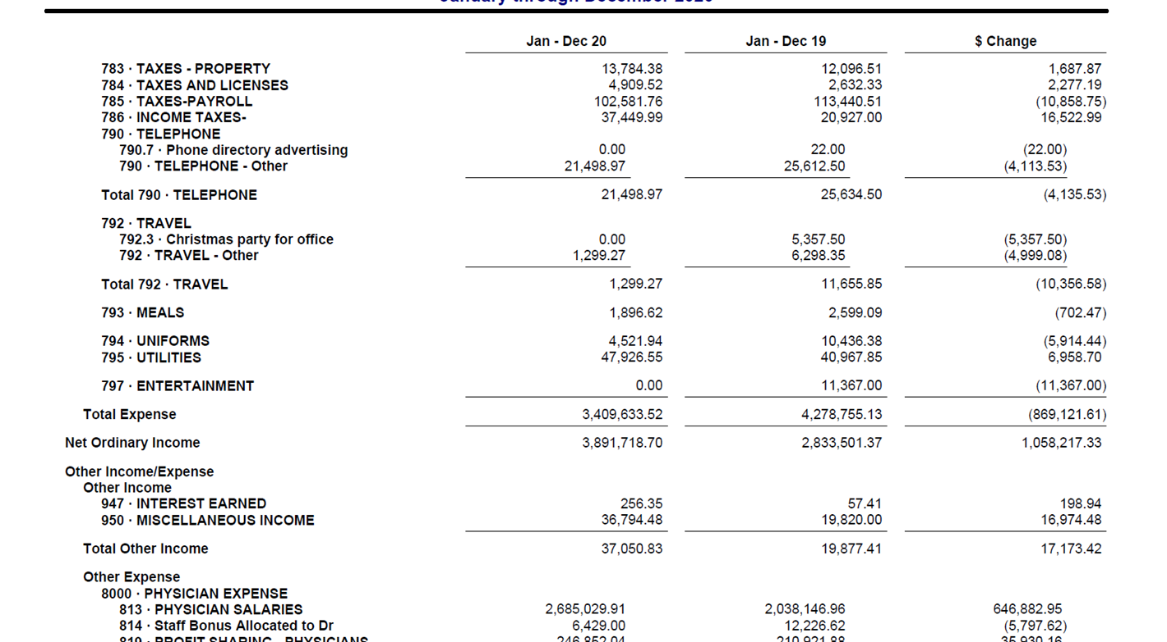
INCOME STATEMENT

Slide 8
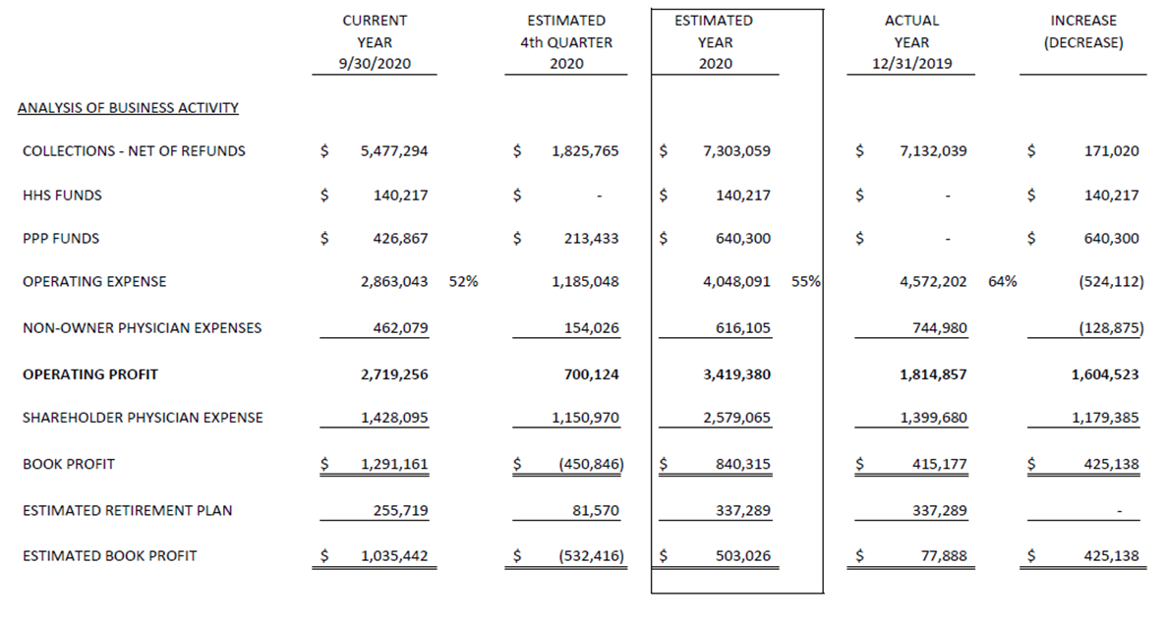
YEAR END PLANNING

Slide 9
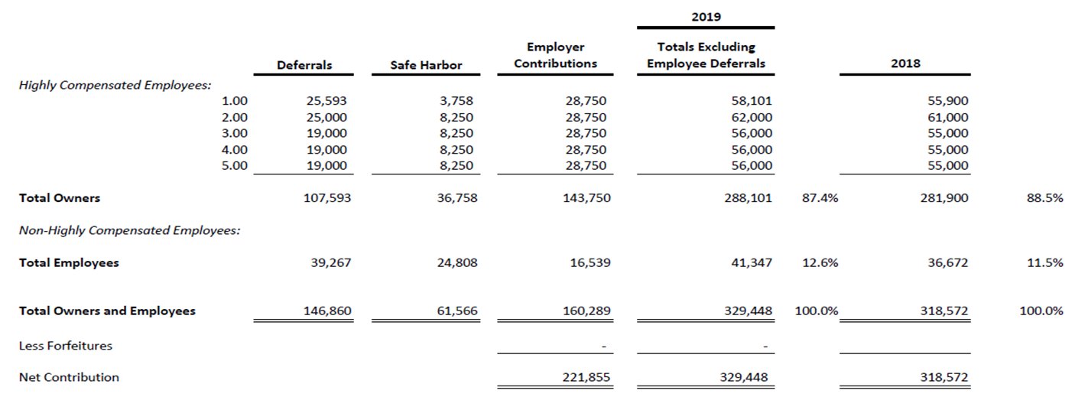
RETIREMENT CALCULATION

Slide 10
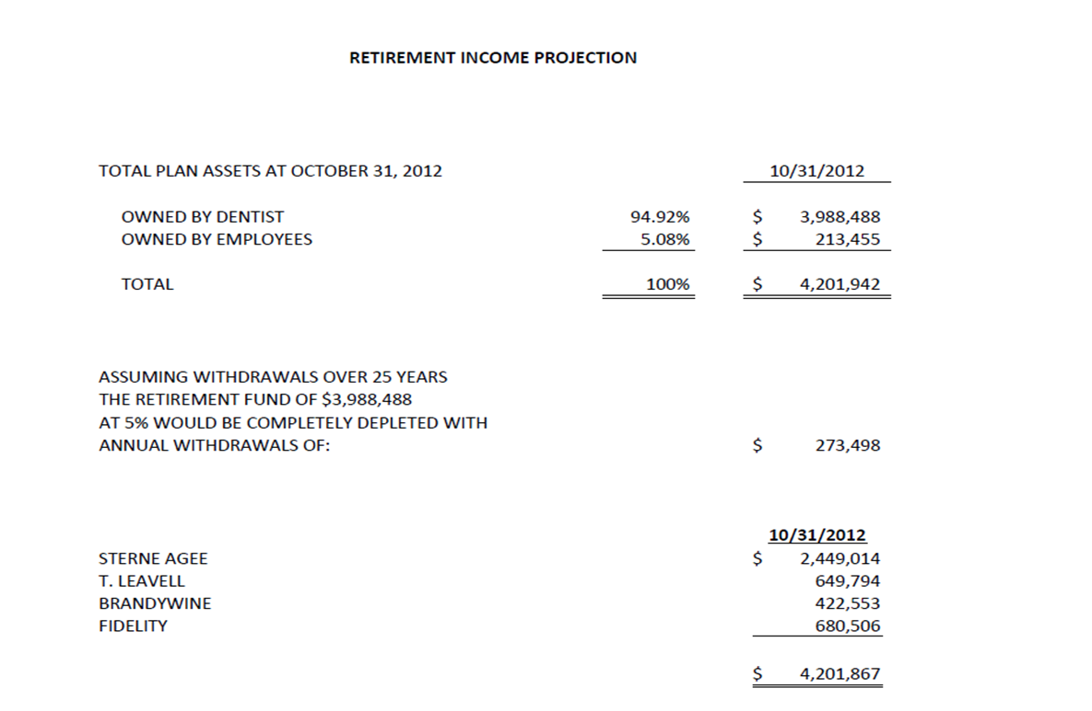
RETIREMENT INCOME GROWTH

Slide 11
WHAT DO WE PRESENT?
Practice Profitability
Financial Strength (not the same as profitability if they strip it all out)
Breakeven point in charges
Effort by Individual doctor
Differences among doctors
Procedure mix
Payor mix
Courtesy discounts
Ancillary tests ordered
Ancillary revenue Split- professional vs. technical

Slide 12
WHAT DO WE PRESENT?
How does current year compare to prior year? What does the trend indicate?
Overhead as:
a % of collections
amount per doctor
How do our results compare to others: Nationally and Locally
Progress toward retirement fund
Are your staff fairly compensated
Details of overtime paid by employee

Slide 13
WHAT DO WE PRESENT?
Retirement plan performance, cost in staff contribution
Profitability of non-owner doctors
E&M coding patterns, potential problems, possible opportunities
Physician compensation illustrations

Slide 14
HOW DO WE MAKE IT INTERESTING?
Keep it pertinent to their issues or interests
Listen to their complaints during the day and be prepared with data to address them
Keep it fresh
Tell them what to think about it
Tell them what to do with it and conclude with action steps

Slide 15
D. MADDOX CASEY, CPA
Partner
2500 Acton Road | Birmingham, AL
Office 205.769.3392
Maddox.Casey@warrenaverett.com

